Slide 1

Unit-3 Project Scope and Time Management
Project Management Tools (PMT)
2305CS322
Prof. Mayur Padia
Computer Engineering Department
mayur.padia@darshan.ac.in
99255 15118

Slide 2
Outline
Some Facts and Figures
Key Terms
Planning Scope Management
Collecting Requirements
Creating the Breakdown Structure
Validating and Controlling Scope
Planning Schedule Management
Sequencing Activities
Estimating Activity Resources and Duration
Developing the Schedule using tools like Gantt Charts, PERT, Agile Management
Controlling Schedule
Quiz

Slide 3



Some Facts and Figures
Source
31.1%
52.7%
16.2%
Software Projects Cancelled before completion.
Exceed Original Budgets by 189%.
Projects Completed on
Time and within Budget.
Common Causes of Project Failure
Poor requirement gathering cited as the leading cause in 39.03% of failures.
Inadequate planning and lack of communications are also significant contributors, with 57% of failing projects attributed to communication breakdowns.
Scope creep, unclear objectives and outcomes (32%)
Insufficient involvement from senior management (37%)
29% of failures are due to poor or inadequate testing

Slide 4
Key Terms
Section - A

Slide 5
Key Terms
Scope
Scope Management
Benchmarking
WBS Dictionary
Scope Validation
Variance
Milestone
Dependencies
Gantt Charts
PERT

Slide 6
Scope
It refers to all the work involved in creating the products of the project and the processes used to create them.

Slide 7
Deliverables
It can be product-related, such as a piece of hardware or software, or process-related, such as a planning document or meeting minutes.

Slide 8
Project Scope Management
It includes the processes involved in defining and controlling what work is or is not included in a project.
It ensures that the project team and stakeholders have the same understanding of what products the project will produce and what processes the project team will use to produce them.
Six main processes involved in project scope management are:
Planning scope management
Collecting requirements
Defining scope
Creating the WBS
Validating scope
Controlling scope

Slide 9
Main Processes in Project Scope Management
Processes | Description | Output
Planning scope management | Here, determining how the project’s scope and requirements will be managed. | Scope management plan Requirements management plan
Collecting requirements | Define and document the features and functions of the products and processes used for creating them. | Requirements documentation Requirements traceability matrix
Define Scope | Review the scope management plan, project charter, requirements documents, and organizational process assets to create a scope statement. | Project scope statement Project documents updates
Create WBS | Subdivide the major project deliverables into smaller, more manageable components. | Scope baseline Project documents updates
Validate scope | Formalize acceptance of the project deliverables. | Accepted deliverables Change requests Work performance information Project documents updates

Slide 10
Main Processes in Project Scope Management (contd.)
Processes | Description | Output
Control Scope | Control changes to project scope throughout the life of the project. | Work performance information Change requests Project management plan updates Project documents Organizational process assets updates

Slide 11
Planning Scope Management
Section - 1

Slide 12

How the scope will be managed throughout the life of a project?

Slide 13

Planning Scope Management
The project team uses expert judgment and meetings to develop two important outputs:
The scope management plan
The requirements management plan
The scope management plan is a secondary part of the project management plan.
It can be informal and broad or formal and detailed.
Here, decision is taken after reviewing the project management plan, project charter, enterprise environmental factors, and organizational process assets.

Slide 14



Scope Management Plan
Scope Management Plan includes:
1
2
3
How to prepare detailed Project Scope Statement
How to maintain and approve the WBS
How to create a WBS
Are there templates or guidelines to follow?
How much detail is needed to describe each deliverable?
This section of the scope management plan would provide suggestions, samples, and resources for creating a WBS.
It describes guidelines for maintaining the WBS and getting approval for it.

Slide 15


Scope Management Plan
Scope Management Plan includes:
4
How to obtain formal acceptance of the completed project deliverables?
5
How to control requests for changes to the project scope
It is important to understand the process for obtaining formal acceptance of completed deliverables, especially for projects in which payments are based on formal acceptance.
It specify how to handle change requests for the project.

Slide 16
The PMBOK® Guide describes
Requirements as conditions or capabilities that must be met by the project or present in the product, service, or result to satisfy an agreement or other specification.
Requirements include the calculated and documented needs and expectations of the sponsor, customer, and other stakeholders.
Requirements need to be analyzed, and recorded in enough detail to be included in the scope baseline and be measured once project execution begins.

Slide 17
Requirements Management Plan
The requirements management plan documents how project requirements will be analyzed, documented, and managed.
A requirements management plan can include the information like:
Information | Examples
How to plan, track, and report requirements activities | Plan: User registration, product catalog, shopping cart, checkout process, and order tracking Track: Use JIRA to track the progress of each requirement through its lifecycle. Report: Use JIRA to generate reports on the status of requirements, such as completed, in-progress, or pending.
How to perform configuration management activities | Version control, Use JIRA for tracking change requests, Jenkins for automated builds and deployment, audit the configurations to ensure that all changes are documented
How to prioritize requirements | Use tools like JIRA to reflect the prioritization in the backlog

Slide 18
Requirements Management Plan
Information | Examples
How to use product metrics | Use tools like Google Analytics, New Relic, and Splunk to collect and monitor metrics
How to trace and capture attributes of requirements | Use tools like JIRA, or Confluence to maintain traceability and capture attributes

Slide 19
Collecting Requirements
Section - 2

Slide 20
Collecting Requirements
A major consequence of not defining requirements well is rework, which can consume up to half of project costs.
It costs much more (up to 30 times more) to correct a software defect in later development phases than to fix it in the requirements phase.
In all types of industries it is important to understand requirements as early as possible.
E.g., if you are designing a house, it is much cheaper to decide where windows and walls will be on paper or a computer screen than after the entire house is framed.
Many projects struggle because people don't properly gather and document requirements.

Slide 21



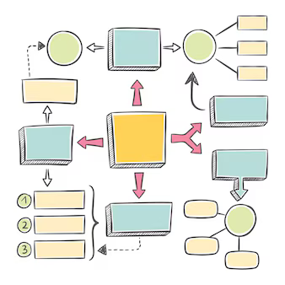


Different Ways to Collect Requirements
Interviewing Stakeholders
Observations
Very effective, but it can be expensive and time-consuming sometimes.
Good technique for projects that involve improving work processes and procedures.
Focus Group
Context Diagram
Use group creativity and decision-making techniques to collect requirements. It is normally faster and less expensive than one-on-one interviews.
It clarify the interfaces and boundaries of a project or process.
Surveys
Benchmarking
Efficient ways to collect requirements in large number.
Compare specific project practices or product characteristics to those of other projects or products

Slide 22
Various Ways to Document Requirements
Review the project charter - it includes high-level requirements
Refer to the scope and requirements management plans
Review the stakeholder register and stakeholder management plan to ensure that all key stakeholders have a say in determining requirements.
It include text, images, diagrams, videos, and other media.
Requirements are often broken down into different categories such as functional requirements, service requirements, performance requirements, quality requirements, and training requirements.
A requirements traceability matrix (RTM) is a table that lists requirements, their various attributes, and the status of the requirements to ensure that all are addressed.
The main purpose of an RTM is to maintain the linkage from the source of each requirement through its decomposition to implementation and validation.
Requirement No. | Name | Category | Source | Status
R32 | Laptop memory (16 GB) | Hardware | Project charter and corporate laptop specifications. | Complete.

Slide 23
Defining Scope
Section - 3

Slide 24



Defining Scope
Scope management is to provide a detailed definition of the work required for the project.
Benefits
Tools
Output
It helps improve the accuracy of time, cost, and resource estimates.
It defines a starting point for performance measurement and project control.
It helps in communicating clear work responsibilities.
It includes expert judgment, product analysis, and workshops.
E.g., face-to-face meeting or virtual meeting to exchange ideas about a new product.
Project scope statement and project documents updates.

Slide 25
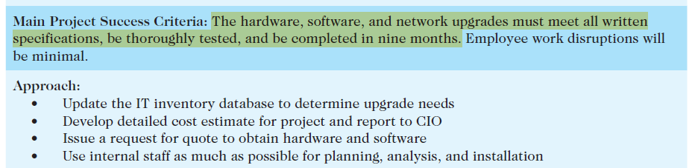
Defining Scope
Key inputs for preparing the project scope statement include the project charter, scope management plan, requirements documentation, and organizational process assets such as policies and procedures related to scope statements, as well as project files and lessons learned from previous/similar projects.
Project scope statements should include at least a product scope description, product user acceptance criteria, and detailed information on all project deliverables.
An up-to-date project scope statement is an important document for developing and confirming a common understanding of the project scope.
It describes in detail the work to be accomplished on the project and important tool for ensuring customer satisfaction and preventing scope creep.
Scope

Slide 26
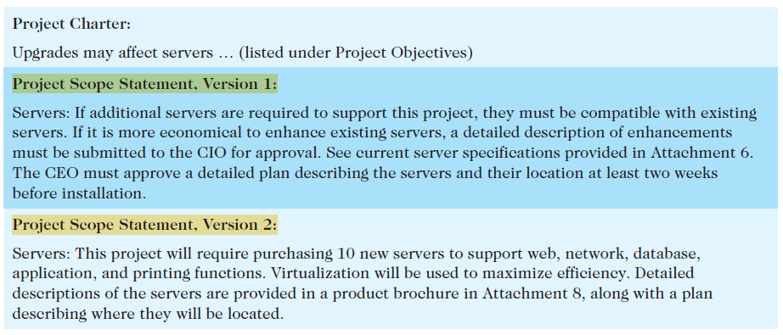
Defining Scope (contd.)
Sample: Defining project scope

Slide 27
Creating the Breakdown Structure
Section - 4

Slide 28
Work Breakdown Structure
A work breakdown structure (WBS) is a deliverable-oriented grouping of the work involved in a project that defines its total scope.
The WBS is a base document in project management because it provides the basis for planning and managing project schedules, costs, resources, and changes.
“It is believed that the work should not be done on a project if it is not included in the WBS.”
The project scope management plan, scope statement, requirements documentation, enterprise environmental factors, and organizational process assets are the primary inputs for creating a WBS.

Slide 29
Work Breakdown Structure (contd.)
Benefits
Tools
Output
Enhanced Project Planning and Management
Improved Communication and Collaboration
Effective Risk Management
Decomposition – Subdividing project deliverables into smaller pieces
The scope baseline and project documents updates.
The scope baseline includes the approved project scope statement and its associated WBS and WBS dictionary.

Slide 30
What does a WBS look like?

Slide 31
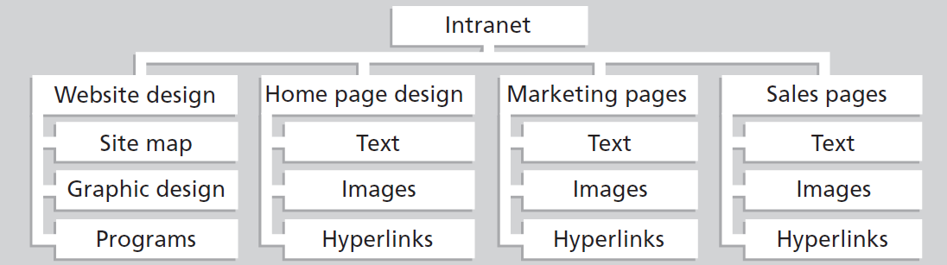
WBS Structure
A WBS is represented as a task-oriented tree of activities, similar to an organizational chart.
A project team often organizes the WBS around project products, project phases, or the project management process groups.

Slide 32
WBS Structure (contd.)
Sample Link
A work package is a task at the lowest level of the WBS.
It also represents the level of work that the project manager monitors and controls.
A work package represent work completed in one week or less.
If a project has a very long time frame and requires quarterly progress reports, a work package might represent work completed in one month or more.
A work package should be defined at the proper level so the project manager can clearly establish an estimate of the effort needed to complete it.
Estimate the cost of all required resources, and evaluate the quality of the results when the work package is finished.
Main concern when creating a WBS is how to organize it to provide the basis for the project schedule.
Focus on what work needs to be done and how it will be done, not when it will be done.

Slide 33
Approaches to Develop WBS
Several approaches to develop a work breakdown structure are:
Using guidelines
E.g. DoD provided WBS
The analogy approach
E.g. Use a similar project’s WBS as a starting point
The top-down approach
It start with the largest items of the project and breaking it into subordinate items
The bottom-up approach
E.g. Team members aggregate the specific tasks and organize them into summary activities, or higher levels in the WBS
The mind-mapping approach
E.g. SWOT Analysis

Slide 34
WBS Dictionary
It is a document that provides detailed information about each WBS item.
It is a definition of the work involved in the task — a clarification that makes the summary description in the WBS easier to understand in terms of the approach taken to complete the work.

Slide 35
Creating a WBS and WBS Dictionary
Sample Link
Basic principles for creating good WBS and its WBS dictionary are:
A unit of work should appear in only one place in the WBS.
The work content of a WBS item is the sum of the WBS items below it.
A WBS item is the responsibility of only one person, even though many people might be working on it.
The WBS must be consistent with the way work actually will be performed; it should serve the project team first, and serve other purposes only if practical.
Project team members should be involved in developing the WBS to ensure consistency and buy-in.
Each WBS item must be documented in a WBS dictionary to ensure accurate understanding of the scope of work included and not included in that item.
The WBS must be a flexible tool to accommodate inevitable changes while properly maintaining control of the work content in the project according to the scope statement.

Slide 36
Validating and Controlling Scope
Section - 4

Slide 37
Validating Scope
Even when the project scope is fairly well defined, many IT projects suffer from scope creep – the tendency for project scope to keep getting bigger and bigger.
It is very important to verify the project scope with users throughout the life of the project and develop a process for controlling scope changes.
Scope validation involves formal acceptance of the completed project deliverables.
The acceptance is achieved by a customer inspection and then sign-off on key deliverables.
To receive formal acceptance of the project scope, the project team must develop clear documentation of the project’s products and procedures to evaluate whether they were completed correctly and satisfactorily.
To minimize scope changes, it is crucial to do a good job of configuration management and validating project scope.

Slide 38

Validating Scope (contd.)
Input
Tools
Output
The scope management plan
Scope baseline
Requirements documentation
Requirements traceability matrix
Validated deliverables
Work performance data
Inspection and group decision-making techniques
The customer, sponsor, or user inspects the work after it is delivered and decides if it meets requirements.
Accepted deliverables
Change requests
Work performance information
Project documents updates.

Slide 39
Controlling Scope
Scope control involves managing changes to the project scope while keeping project goals and business strategy in mind.
The goal of scope control is to impact the factors that cause scope changes, to ensure that changes are processed according to procedures developed as part of integrated change control, and to manage changes when they occur.
You also need to develop a process for soliciting and monitoring changes to project scope.
Stakeholders should be encouraged to suggest changes that will benefit the overall project and discouraged from suggesting unnecessary changes.

Slide 40
Controlling Scope (contd.)
Input
Tools
Output
The project management plan, requirements documentation, requirements traceability matrix, work performance data, and organizational process assets.
An important tool for performing scope control is variance analysis.
Variance is the difference between planned and actual performance.
Work performance information, change requests, project management plan updates, project documents updates, and organizational process assets updates.

Slide 41
Suggestions for Improving Users’ Input
Develop a good project selection process for IT projects.
Have users on the project team.
Have regular meetings with defined agendas.
Deliver something to project users and sponsors on a regular basis.
Do not promise to deliver what the team cannot deliver in a particular time frame.

Slide 42
Planning Schedule Management
Section - 5

Slide 43
Importance of Project Schedule
Project time management, involves the processes required to ensure timely completion of a project.
Seven main processes involved in project time management are:
Planning schedule management involves determining the policies, procedures, and documentation that will be used for planning, executing, and controlling the project schedule.
Main Output => Schedule Management Plan
Defining activities involves identifying the specific activities that the project team members and stakeholders must perform to produce the project deliverables.
An activity or task is an element of work normally found on the work breakdown structure (WBS) that has expected duration, cost, and resource requirements.
Main Output => activity list, activity attributes, a milestone list, and project management plan updates.
Sequencing activities involves identifying and documenting the relationships between project activities.
Main Output => project schedule network diagrams and project documents updates

Slide 44
Importance of Project Schedule (contd.)
Estimating activity resources involves estimating how many resources people, equipment, and materials—a project team should use to perform project activities.
Main Output => activity resource requirements, a resource breakdown structure, and project documents updates
Estimating activity durations involves estimating the number of work periods that are needed to complete individual activities.
Main Output => activity duration estimates and project documents updates
Developing the schedule involves analyzing activity sequences, activity resource estimates, and activity duration estimates to create the project schedule.
Main Output => schedule baseline, project schedule, schedule data, project calendars, project management plan updates, and project documents updates
Controlling the schedule involves controlling and managing changes to the project schedule.
Main Output => work performance information, schedule forecasts, change requests, project management plan updates, project documents updates, and organizational process assets updates.

Slide 45
Project Schedule Management
The first step in project time management is planning how the schedule will be managed throughout the life of the project.
Project schedules grow out of the basic documents that initiate a project.
The project charter often mentions planned project start and end dates, which serve as the starting points for a more detailed schedule.
It can be informal and broad or formal and detailed.

Slide 46
Project Schedule Management (contd.)
A schedule management plan includes the following information:
Project schedule model development: Many projects include a schedule model, which contains project activities with estimated durations, dependencies.
Level of accuracy and units of measure: How accurate schedule estimates should be and determines whether time is measured in hours, days, or another unit.
Control thresholds: Variance thresholds, such as ±10%, are established for monitoring schedule performance.
Rules of performance measurement: E.g., if team members are expected to track the percentage of work completed, this section specifies how to determine the percentages.
Reporting formats: This section describes the format and frequency of schedule reports required for the project.
Process descriptions: The schedule management plan also describes how all of the schedule management processes will be performed.

Slide 47
Sequencing Activities
Section - 6

Slide 48
Defining Activities
Defining activities involves identifying the specific actions that will produce the project deliverables in enough detail to determine resource and schedule estimates.
To begin defining activities, the project team reviews:
Schedule management plan
Scope baseline
Enterprise environmental factors, and
Organizational process assets

Slide 49
Defining Activities (contd.)
Outputs of this process includes:
Title | Description
Activity List | The activity list is a tabulation of activities to be included on a project schedule. The list should include the activity name, an activity identifier or number, and a brief description of the activity. The goal of defining activities is to ensure that the project team completely understands all the work it must do as part of the project scope so they can start scheduling the work. The project team must understand what the item means before team members can make schedule-related decisions.
Activity Attributes | The activity attributes provide schedule-related information about each activity, such as predecessors, successors, logical relationships, leads and lags, resource requirements, constraints, imposed dates, and assumptions related to the activity. The activity list and activity attributes should agree with the WBS and WBS dictionary.

Slide 50
Defining Activities (contd.)
Outputs of this process includes:
Title | Description
Milestone List | A milestone in a project is a significant event. It often takes several activities and a lot of work to complete a milestone, but the milestone itself is a marker to help in identifying necessary activities. Milestones are also useful tools for setting schedule goals and monitoring progress.

Slide 51
Sequencing Activities
The sequencing process involves evaluating the reasons for dependencies and the different types of dependencies.
Inputs to the activity sequencing process includes:
The schedule management plan
Activity list and attributes
Project scope statement
Milestone list
Organizational process assets

Slide 52
Dependencies
A dependency or relationship pertains to the sequencing of project activities or tasks.
E.g., does a certain activity have to be finished before another can start?
Can the project team do several activities in parallel?
Can some activities overlap?
Determining these relationships or dependencies among activities is essential for developing and managing a project schedule.
There are three basic reasons for identifying dependencies among project activities:
Mandatory dependencies are inherent in the nature of the work being performed on a project. They are sometimes referred to as hard logic.
E.g., you cannot test code until after the code is written.
Discretionary dependencies are defined by the project team.
E.g., a project team not starting the detailed design of a new information system until the users sign off on all of the analysis work.
Discretionary dependencies are sometimes referred to as soft logic.

Slide 53
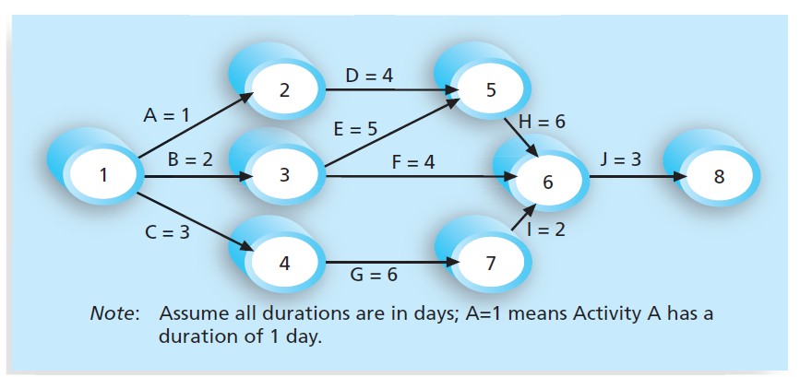
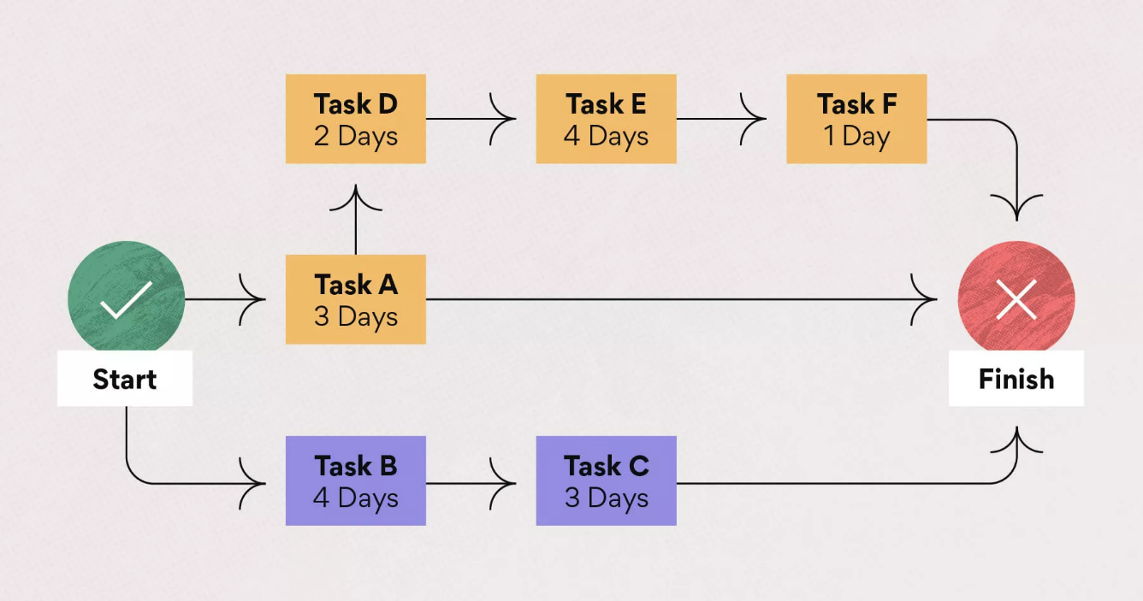
Dependencies (contd.)
External dependencies involve relationships between project and non-project activities.
E.g., the installation of a new operating system and other software may depend on delivery of new hardware from an external supplier.
If you do not define the sequence of activities, you cannot use some of the most powerful scheduling tools available to project managers:
Network diagrams
Critical path analysis
Network diagram
Critical path analysis

Slide 54
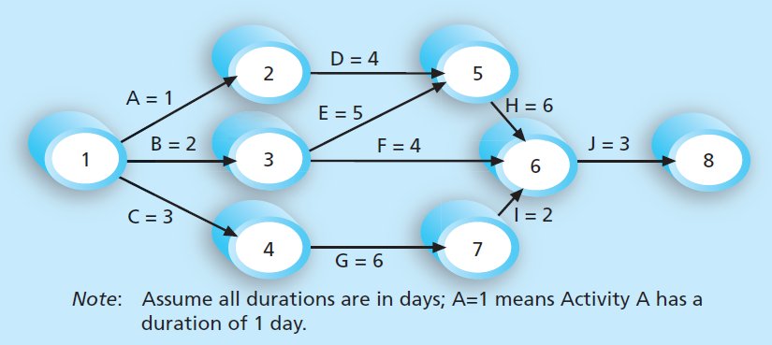
Network Diagrams
A network diagram is a graphic representation of the logical relationships among project activities and their sequencing.
The letters A through J represent activities with dependencies that are required to complete the project.
These activities come from the WBS.
The arrows represent the activity sequencing or relationships between tasks.
E.g., Activity A must be done before Activity D, and Activity D must be done before Activity H.

Slide 55
Network Diagrams (contd.)
The format of this network diagram uses the activity-on-arrow (AOA) approach or the arrow diagramming method (ADM)
In this technique activities are represented by arrows and connected at points called nodes to illustrate the sequence of activities.
A node is simply the starting and ending point of an activity.
The first node signifies the start of a project, and the last node represents the end.
Every activity on the network diagram must be completed in order to finish the project.
Not every item on the WBS needs to be shown on the network diagram; only activities with dependencies need to be shown.

Slide 56
Steps to Create AOA Network Diagram
Find all of the activities that start at Node 1.
Draw their finish nodes, and draw arrows between Node 1 and each of the finish nodes.
Put the activity letter or name on the associated arrow.
If you have a duration estimate, write it next to the activity letter or name.
E.g., A = 1 means that the duration of Activity A is one day, week, or other standard unit of time.
Look for bursts and merges.
Bursts occur when two or more activities follow a single node.
A merge occurs when two or more nodes precede a single node.
E.g., in Figure, Node 1 is a burst because it goes into Nodes 2, 3, and 4. Node 5 is a merge preceded by Nodes 2 and 3.
Continue drawing the AOA network diagram until all activities are included.
As a rule of thumb, all arrowheads should face toward the right.

Slide 57
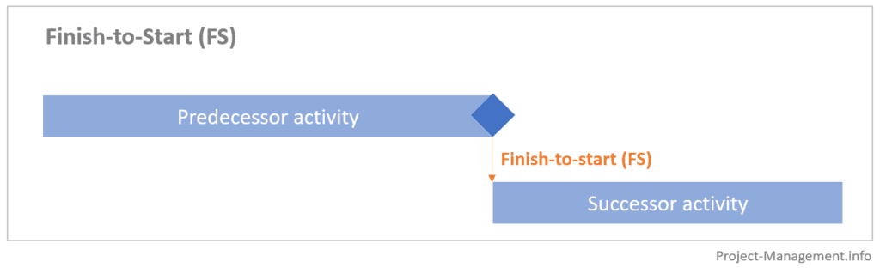
Types of Task Dependencies
Types of task dependencies that can occur among project activities are:
Finish-to-Start (FS) – Task (B) cannot start until task (A) finishes. E.g., you cannot provide user training until after software or a new system has been installed

Slide 58
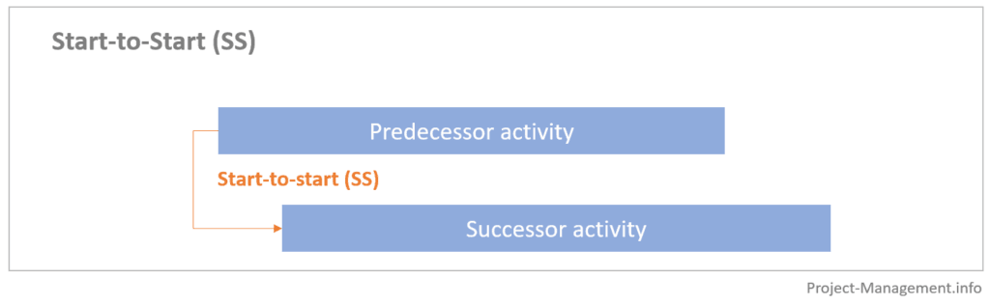
Types of Task Dependencies
Start-to-Start (SS) – Task (B) cannot start until task (A) starts. E.g., in an IT projects, a group of activities might start simultaneously.

Slide 59
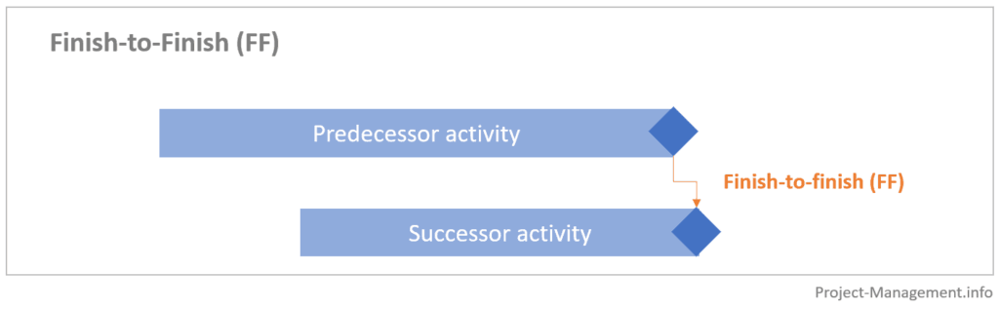
Types of Task Dependencies
Finish-to-finish (FF) – Task (B) cannot finish until task (A) finishes. E.g., quality control efforts cannot finish before production finishes, although the two activities can be performed at the same time.

Slide 60
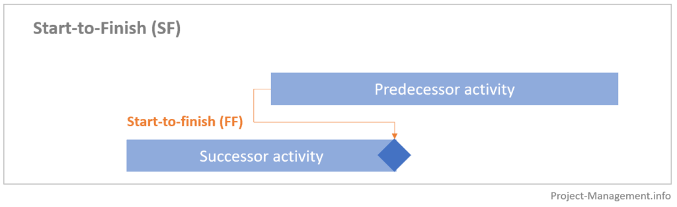
Types of Task Dependencies
Start-to-finish (SF) – Task (B) cannot finish until task (A) starts. E.g., an organization might strive to stock raw materials just in time for the manufacturing process to begin.

Slide 61
Exercise 1
Activity | Initial Node | Final Node | Estimated Duration
A | 1 | 2 | 2
B | 2 | 3 | 2
C | 2 | 4 | 3
D | 2 | 5 | 4
E | 3 | 6 | 2
F | 4 | 6 | 3
G | 5 | 7 | 6
H | 6 | 8 | 2
I | 6 | 7 | 5
J | 7 | 8 | 1
K | 8 | 9 | 2
Draw an AOA network diagram representing the project. Put the node number in circles and draw arrows from node to node, labelling each arrow with the activity letter and estimated time.
Identify all of the paths on the network diagram and note how long they are.
What is the critical path for this project and how long is it?
What is the shortest possible time needed to complete this project?

Slide 62
Exercise 2
Activity | Initial Node | Final Node | Estimated Duration
A | 1 | 2 | 10
B | 1 | 3 | 12
C | 1 | 4 | 8
D | 2 | 3 | 4
E | 2 | 5 | 8
F | 3 | 4 | 6
G | 4 | 5 | 4
H | 4 | 6 | 8
I | 5 | 6 | 6
J | 5 | 8 | 12
K | 6 | 7 | 8
L | 7 | 8 | 10
Draw an AOA network diagram representing the project. Put the node number in circles and draw arrows from node to node, labelling each arrow with the activity letter and estimated time.
Identify all of the paths on the network diagram and note how long they are.
What is the critical path for this project and how long is it?
What is the shortest possible time needed to complete this project?

Slide 63
Exercise 3
Activity | Initial Node | Final Node | Estimated Duration
A | 1 | 2 | 5
B | 1 | 3 | 6
C | 1 | 4 | 4
D | 2 | 5 | 7
E | 2 | 6 | 5
F | 3 | 6 | 8
G | 3 | 7 | 6
H | 4 | 7 | 5
I | 5 | 8 | 6
J | 6 | 8 | 4
K | 6 | 9 | 7
L | 7 | 9 | 3
M | 8 | 10 | 5
N | 9 | 10 | 6
O | 10 | 11 | 4
Draw an AOA network diagram representing the project. Put the node number in circles and draw arrows from node to node, labelling each arrow with the activity letter and estimated time.
Identify all of the paths on the network diagram and note how long they are.
What is the critical path for this project and how long is it?
What is the shortest possible time needed to complete this project?

Slide 64
Exercise 4
Activity | Initial Node | Final Node | Estimated Duration
A | 1 | 2 | 6
B | 1 | 3 | 5
C | 1 | 4 | 4
D | 2 | 5 | 3
E | 3 | 5 | 6
F | 4 | 6 | 8
G | 5 | 6 | 5
H | 5 | 7 | 4
I | 6 | 7 | 6
J | 7 | 8 | 7
Draw an AOA network diagram representing the project. Put the node number in circles and draw arrows from node to node, labelling each arrow with the activity letter and estimated time.
Identify all of the paths on the network diagram and note how long they are.
What is the critical path for this project and how long is it?
What is the shortest possible time needed to complete this project?

Slide 65
Estimating Activity Resources and Duration
Section - 7

Slide 66
Estimating Activity Resources
You must have a good idea of the quantity and type of resources (people, equipment, and materials) that will be assigned to each activity.
The nature of the project and the organization will affect resource estimates.
Expert judgment, estimating data, and project management software are tools that can assist in resource estimating.
The people involved must have experience and expertise in similar projects.

Slide 67
Estimating Activity Resources (contd.)
Important questions to answer when estimating activity resources includes:
How difficult will specific activities be on this project?
Is anything unique in the project’s scope statement that will affect resources?
What is the organization’s history in doing similar activities?
Does the organization have people, equipment, and materials that are capable and available for performing the work?
Could any organizational policies affect the availability of resources?
Would it make sense to outsource some of the work?
Will outsourcing increase or decrease the amount of resources needed and when they will be available?

Slide 68
Estimating Activity Resources (contd.)
It is important to thoroughly brainstorm and evaluate alternatives related to resources, especially on projects that involve people from multiple disciplines and companies.
It is often effective to solicit ideas from different people to help develop alternatives and address resource-related issues early in a project.
The main outputs of the resource estimating process include
Activity resource requirement list
Resource breakdown structure
Project documents updates
A resource breakdown structure is a hierarchical structure that identifies the project’s resources by category and type.
Resource categories might include analysts, programmers, and testers.

Slide 69
Estimating Activity Durations
Duration includes the actual amount of time worked on an activity plus elapsed time.
E.g., even though it might take one workweek or five workdays to do the actual work, the duration estimate might be two weeks to allow extra time needed to obtain outside information. The people or resources assigned to a task will also affect the task duration estimate.
One of the most important considerations in making activity duration estimates is the availability of resources, especially human resources.
What specific skills do people need to do the work?
What are the skill levels of the people assigned to the project?
How many people are expected to be available to work on the project at any one time?
A three-point estimate includes an optimistic (three weeks), most likely (four weeks), and pessimistic (five weeks) estimate.
The optimistic estimate is based on a best-case scenario, while the pessimistic estimate is based on a worst-case scenario.

Slide 70
Developing the Schedule using Tools
Section - 8

Slide 71
Developing the Schedule
Schedule development uses the results of all the preceding project time management processes to determine the start and end dates of the project and its activities.
The ultimate goal of developing a realistic project schedule is to provide a basis for monitoring project progress for the time dimension of the project.
The main outputs of this process are
Project schedule,
Schedule baseline
Schedule data
Project calendars
Project management plan updates
Project documents updates
Tools and techniques assist in schedule development:
Gantt chart
Critical path analysis
Critical chain scheduling
PERT analysis

Slide 72
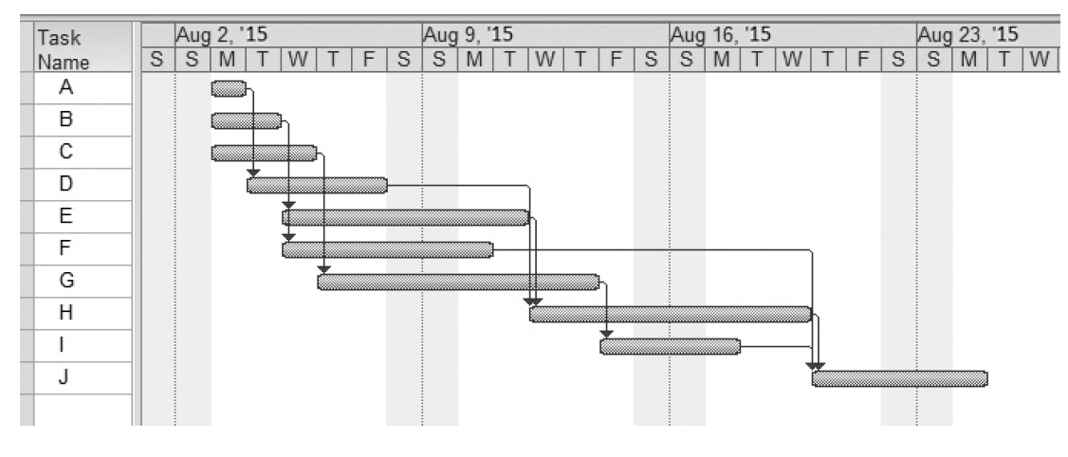
Gantt Charts
Gantt charts provide a standard format for displaying project schedule information by listing project activities and their corresponding start and finish dates in calendar form.
Gantt charts are sometimes referred to as bar charts because the activities’ start and end dates are shown as horizontal bars.

Slide 73
Different Symbols on the Gantt Charts
Symbol | Description
 | Milestone
 | Summary Tasks
 | Task
 | Relationships or dependencies
 | Slipped Milestone

Slide 74
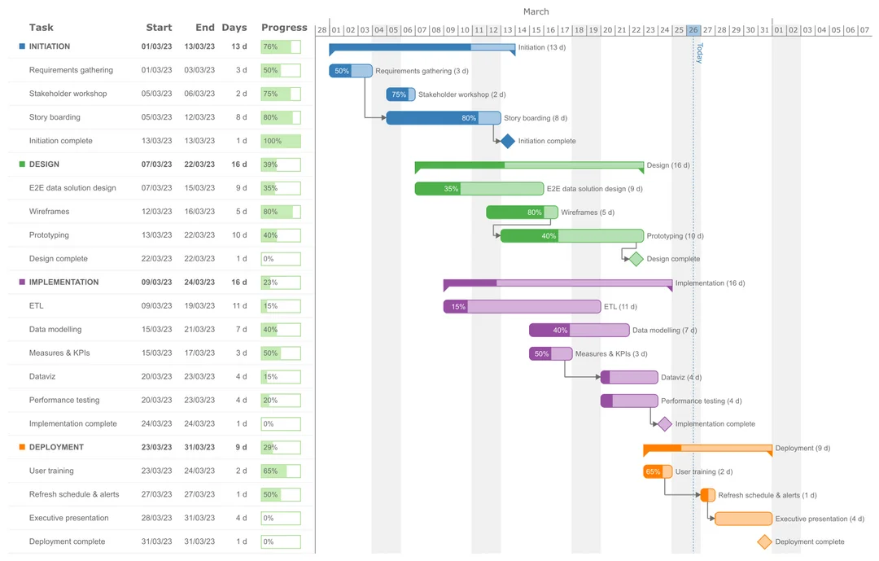
Sample Gantt Chart

Slide 75
Critical Path Method (CPM)
Critical path method (CPM) — also called critical path analysis — is a network diagramming technique used to predict total project duration.
This tool helps you fight against project schedule overruns.
A critical path for a project is the series of activities that determine the earliest time by which the project can be completed.
It is the longest path through the network diagram and has the least amount of slack or float.
Slack or float is the amount of time an activity may be delayed without delaying a succeeding activity or the project finish date. Slack or Float = LS - ES
It helps in identifying which activities have flexibility in their timing, allowing project managers to allocate resources more effectively.
It helps in optimizing the schedule by identifying tasks that can be delayed without impacting the overall project timeline

Slide 76
Critical Path Method (CPM) – contd.
Total slack or total float is the amount of time an activity can be delayed from its early start without delaying the planned project finish date.
A forward pass determines the early start and early finish dates for each activity.
The early start (ES) date is the earliest possible time an activity can start based on the project network logic. ES = (highest) previous EF + 1
The early finish (EF) date is the earliest possible time an activity can finish based on the project network logic. EF = ES + duration - 1
A backward pass through the network diagram determines the late start and late finish dates for each activity in a similar fashion.
The late start (LS) date is the latest possible time an activity might begin without delaying the project finish date. LS = LF – duration + 1
The late finish (LF) date is the latest possible time an activity can be completed without delaying the project finish date. LF = (lower) LS - 1

Slide 77
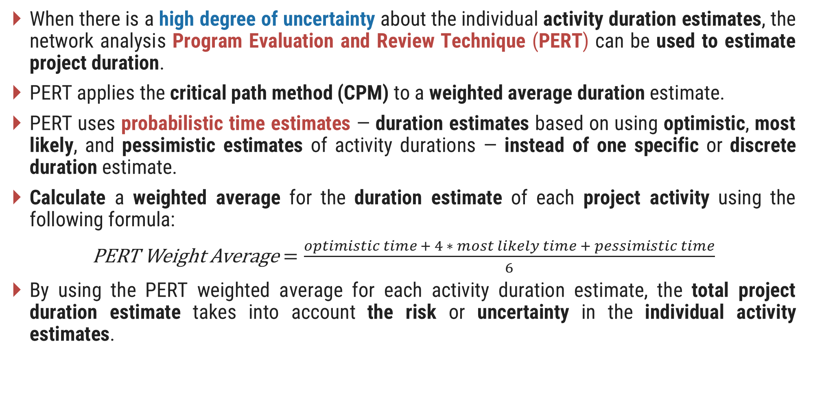
PERT
When there is a high degree of uncertainty about the individual activity duration estimates, the network analysis Program Evaluation and Review Technique (PERT) can be used to estimate project duration.
PERT applies the critical path method (CPM) to a weighted average duration estimate.
PERT uses probabilistic time estimates — duration estimates based on using optimistic, most likely, and pessimistic estimates of activity durations — instead of one specific or discrete duration estimate.
Calculate a weighted average for the duration estimate of each project activity using the following formula:
PERT Weight Average$=\frac{optimistic time + 4 ∗ most likely time + pessimistic time}{6}$
By using the PERT weighted average for each activity duration estimate, the total project duration estimate takes into account the risk or uncertainty in the individual activity estimates.

Slide 78
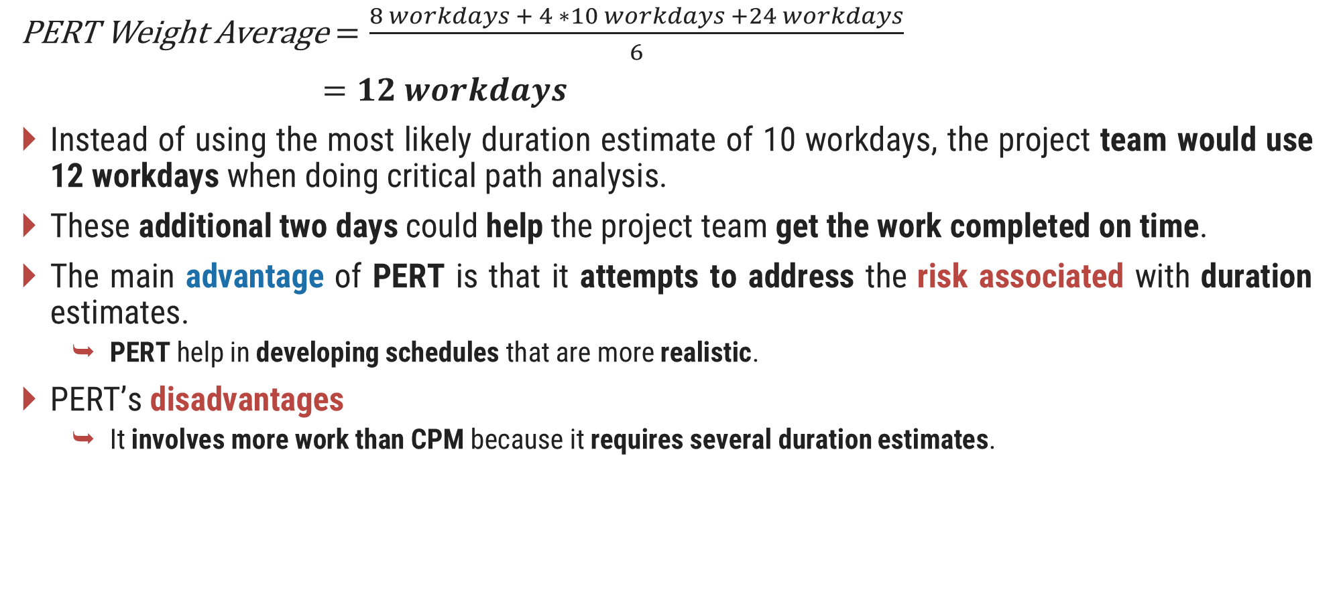
PERT Sample
PERT Weight Average$=\frac{8 workdays + 4 ∗10 workdays +24 workdays}{6}$
$=12 workdays$
Instead of using the most likely duration estimate of 10 workdays, the project team would use 12 workdays when doing critical path analysis.
These additional two days could help the project team get the work completed on time.
The main advantage of PERT is that it attempts to address the risk associated with duration estimates.
PERT help in developing schedules that are more realistic.
PERT’s disadvantages
It involves more work than CPM because it requires several duration estimates.

Slide 79
Controlling Schedule
Section - 9

Slide 80
Controlling the Schedule
Schedule control is a portion of the integrated change control process in project integration management.
The goal of schedule control is to know the status of the schedule, influence the factors that cause schedule changes, determine that the schedule has changed, and manage changes when they occur.
The main inputs to schedule control are the
Project management plan
Project schedule
Work performance data
Project calendars
Schedule data
Organizational process assets

Slide 81
Controlling the Schedule (contd.)
Some of the tools and techniques include:
Performance reviews, where progress reports are often provided
Schedule change control system, operated as part of the integrated change control system
Scheduling tool and/or project management software, as Project 2013
Variance analysis, such as analyzing float or slack and using earned value
What-if scenario analysis, which can be done manually or with the aid of software
Adjusting leads and lags
Schedule compression, such as crashing and fast tracking
Resource optimization techniques, such as resource leveling

Slide 82
Controlling the Schedule (contd.)
The main outputs of schedule control include
Work performance measurements
Organizational process assets updates such as lessons-learned reports related to schedule control
Change requests
Project management plan updates
Project documents updates

Slide 83
Quiz
Section - 8

Slide 84
Quiz
_____ refers to all the work involved in creating the products of the project and the processes used to create them.
Deliverables
Milestones
Scope
Product development
Which tool or technique for collecting requirements is often the most expensive and time consuming?
Interviews
Focus groups
Surveys
Observation

Slide 85
Quiz (contd.)
A _____ is a deliverable-oriented grouping of the work involved in a project that defines its total scope.
scope statement
WBS
WBS dictionary
work package
What approach to developing a WBS involves writing down or drawing ideas in a nonlinear format?
top-down
bottom-up
analogy
mind mapping

Slide 86
Quiz (contd.)
Assume that you have a project with major categories called planning, analysis, design, and testing. What level of the WBS would these items fall under?
0
1
2
3
Which of the following is not a best practice that can help in avoiding scope problems on IT projects?
Keep the scope realistic
Use off-the-shelf hardware and software whenever possible
Follow good project management processes
Don’t involve too many users in scope management

Slide 87
Quiz (contd.)
Scope _____ is often achieved by a customer inspection and then sign-off on key deliverables.
acceptance
validation
completion
close-out
Which of the following is not a suggestion for improving user input?
Develop a good project selection process for IT projects.
Have users on the project team.
Co-locate users with developers.
Only have meetings as needed, not on a regular basis.
Project management software helps you develop a _____, which serves as basis for creating Gantt charts, assigning resources, and allocating costs.
project plan
schedule
WBS
deliverable

Slide 88
Thank You

